Slide 1

Natural Language Processing
Yue Zhang
Westlake University

Slide 2
Overview
Week 2
Overview of NLP architecture
Data and Model
Review of background
Linear Models
Week 3
Week 4
Week 5
Week 6
Week 7
N-gram Language Models
Naïve Bayes
Generative Text Classification
Features
Document Representation
Discriminative Text Classification
Neuron
SGD
Entropy, Perplexity
Word Representation
HMM -- Generative Sturctured Prediction
CRF – Discriminative Structured Prediction
Neural Models
Week 8
Week 10
Week 12
MLP, Multi-Layer Perception
Neural N-gram LM and Word Embedding
Neural Structured Prediction
Sequence-to-sequence
Neural Recurrent Language Models
Week 9
Week 13
Sequence Representation
Neural Text Classification
Week 11
Sequence-level Pre-training
Pre-trained Models for Text Classification and other MLP tasks
Structured Representation
Large Language Models
Week 14
Week 15
Scaling, instruction following and LLMs
LLMs for NLP, AGI and beyond

Slide 3
Week 6
Entropy, Information and Word Representation

Slide 4
Contents
6.1 The maximum entropy principle
6.1.1 Information and entropy
6.1.2 A naïve maximum entropy model
6.1.3 Maximum entropy model and training data
6.2 KL-Divergence, Cross-Entropy and Model Perplexity
6.2.1 KL-divergence
6.2.2 Cross entropy
6.2.3 Model Perplexity
6.3 Mutual information
6.3.1 Pointwise mutual information
6.3.2 Using PMI
6.4 Vector Representation of Words

Slide 5
Contents
6.1 The maximum entropy principle
6.1.1 Information and entropy
6.1.2 A naïve maximum entropy model
6.1.3 Maximum entropy model and training data
6.2 KL-Divergence, Cross-Entropy and Model Perplexity
6.2.1 KL-divergence
6.2.2 Cross entropy
6.2.3 Model Perplexity
6.3 Mutual information
6.3.1 Pointwise mutual information
6.3.2 Using PMI
6.4 Vector Representation of Words

Slide 6
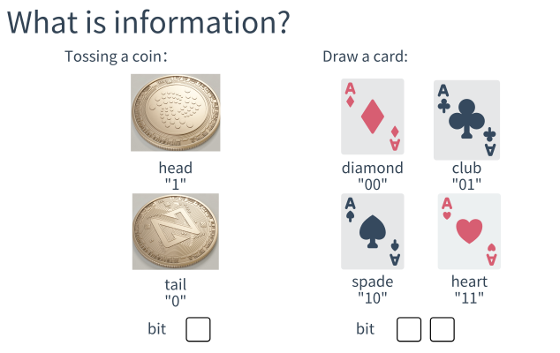
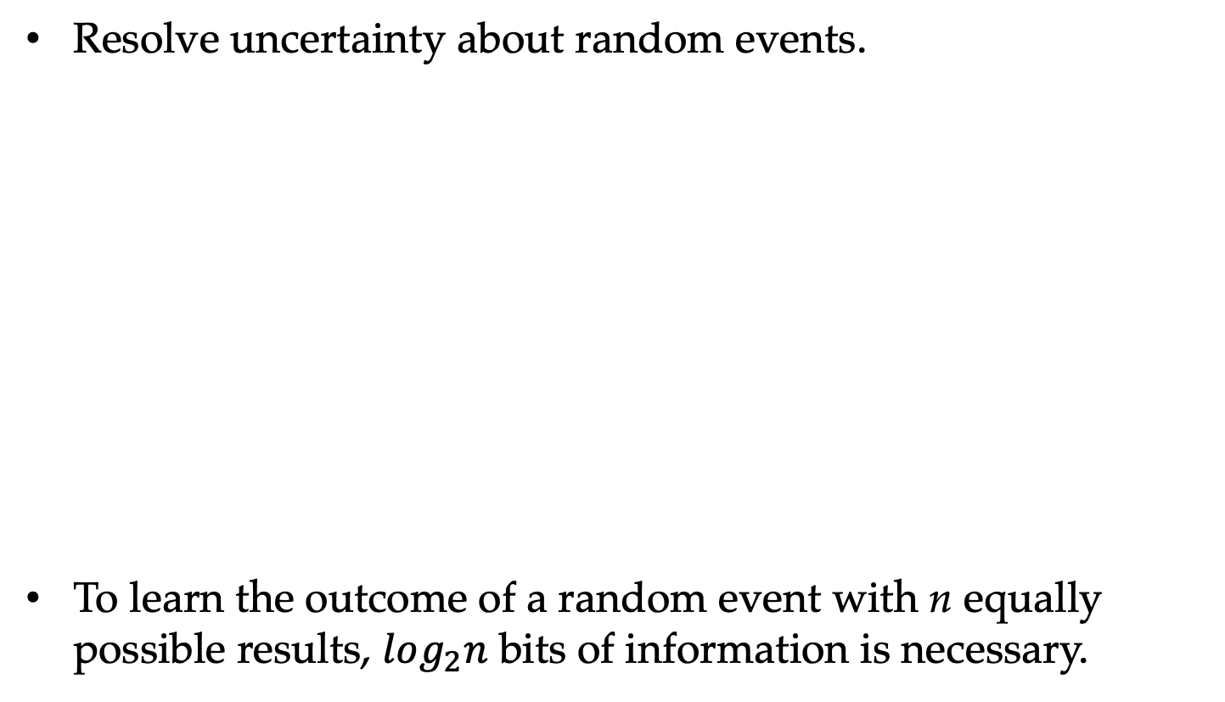
What Is Information?
Resolve uncertainty about random events.
To learn the outcome of a random event with n equally possible results, $log_{2}n$ bits of information is necessary.

Slide 7
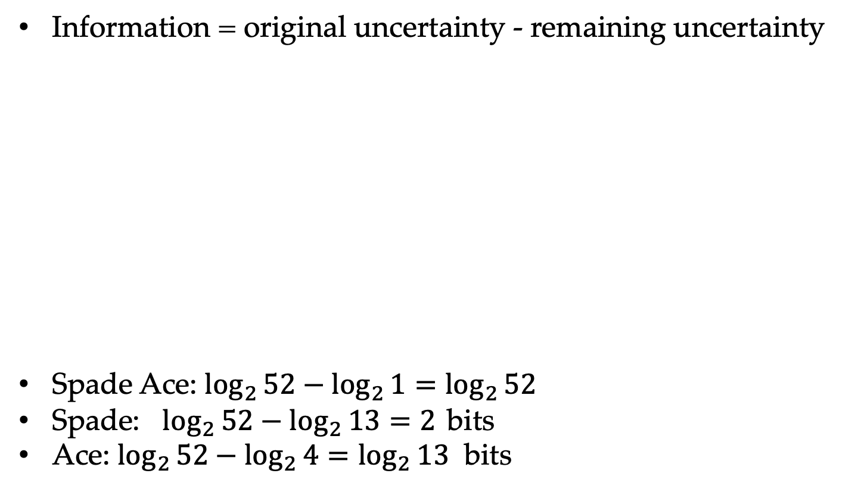
Information of Random Events
Information = original uncertainty - remaining uncertainty
Spade Ace: $\log_{2}{52−\log_{2}{1=\log_{2}{52}}}$
Spade: $\log_{2}{52}−\log_{2}{13}=2$ bits
Ace: $\log_{2}{52}−\log_{2}{4}=\log_{2}{13}$ bits

Slide 8
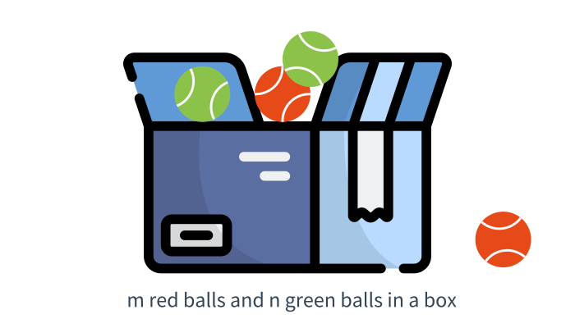
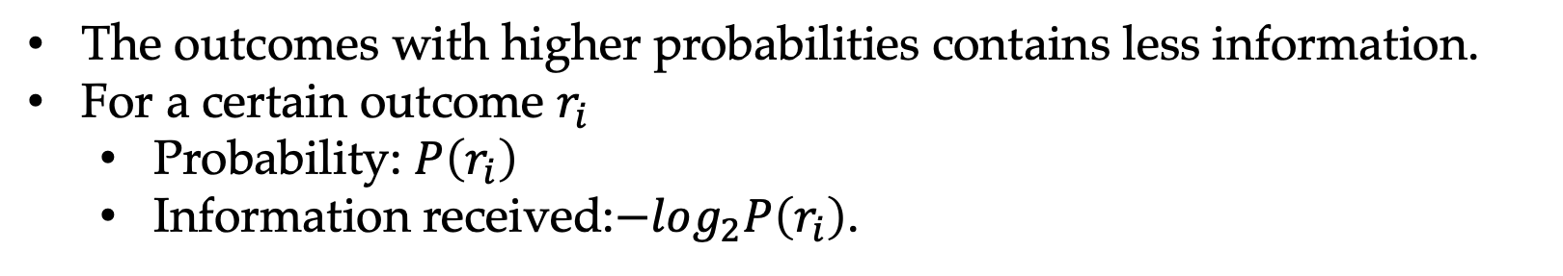
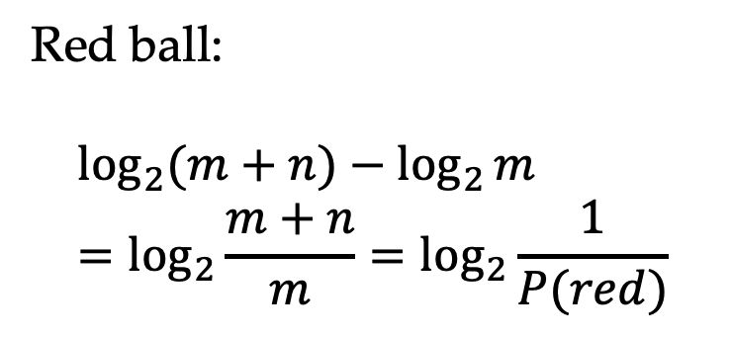
Information for Non-uniform Distributions
Red ball:
$$\log_{2}{(m+n)}−\log_{2}{m}=\log_{2}{\frac{m+n}{m}}=\log_{2}{\frac{1}{P(red)}}$$
The outcomes with higher probabilities contains less information.
For a certain outcome $r_{i}$
Probability: $P\left(r_{i}\right)$
Information received:$−log_{2}P\left(r_{i}\right)$.

Slide 9

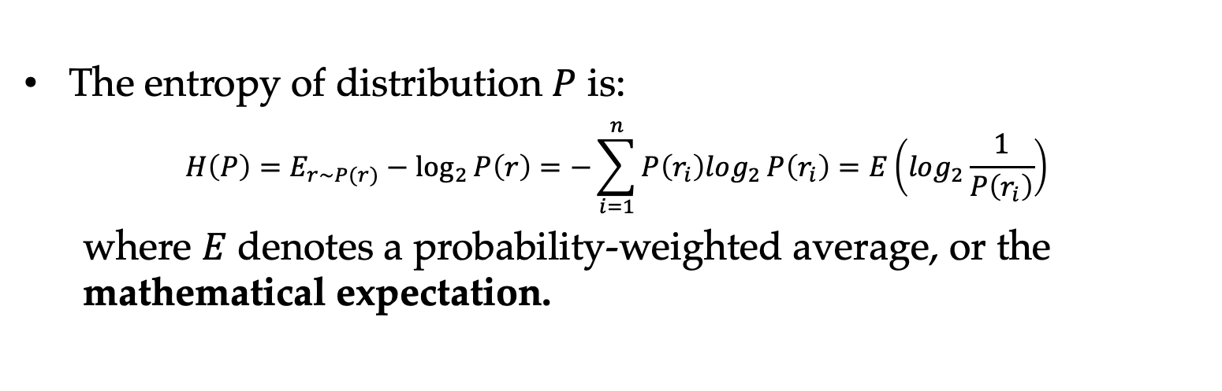
Entropy —— Inherent Uncertainty about Random Events
Entropy describes random events by considering all possible outcomes (i.e., random variables by considering all possible values).
The entropy of distribution $P$ is:
$$H\left(P\right)=E_{r\sim P(r)}−\log_{2}{P\left(r\right)}=−\sum_{i=1}^{n}{P\left(r_{i}\right)log_{2}}P\left(r_{i}\right)=E\left(log_{2}\frac{1}{P\left(r_{i}\right)}\right)$$
where $E$ denotes a probability-weighted average, or the mathematical expectation.

Slide 10
Entropy and Distribution Characteristics
Uniform distributions have the largest entropy.
Encoding six numbers
Uniform distribution
3 bits 001 010 011 100 101 110
90% case with number 1, and 2% with 2, 3, 4, 5, 6
0 1010 1011 1110 1101 1110
0.9 x 1+ 0.1 x 4 =1.3 bits

Slide 11
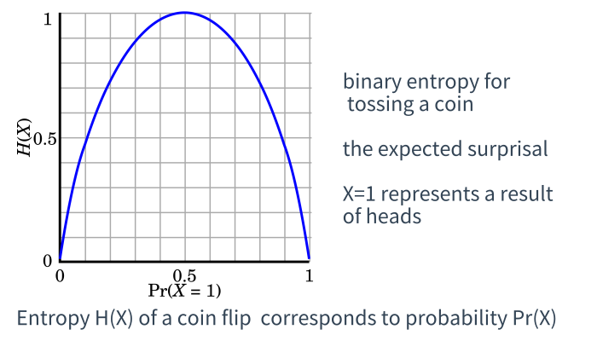
Entropy Measures Uncertainty
Bernoulli Distribution
Events with uniform output distributions have the largest entropy.
The more uneven the distribution is, the smaller the entropy is.

Slide 12
Contents
6.1 The maximum entropy principle
6.1.1 Information and entropy
6.1.2 A naïve maximum entropy model
6.1.3 Maximum entropy model and training data
6.2 KL-Divergence, Cross-Entropy and Model Perplexity
6.2.1 KL-divergence
6.2.2 Cross entropy
6.2.3 Model Perplexity
6.3 Mutual information
6.3.1 Pointwise mutual information
6.3.2 Using PMI
6.4 Vector Representation of Words

Slide 13
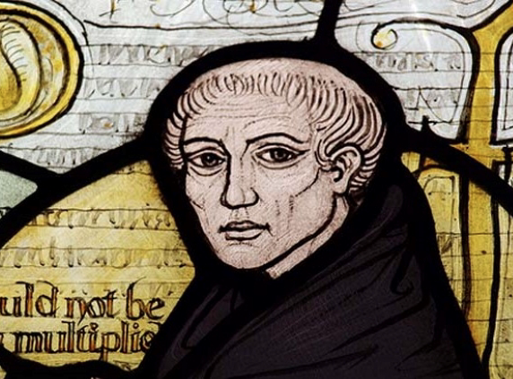
Occam’s Razor
A principle attributed to the fourteenth-century English Franciscan friar William of Ockham, which states that “entities should not be multiplied beyond necessity”
Occam’s razor shares underlying similarities with the maximum entropy principle.

Slide 14
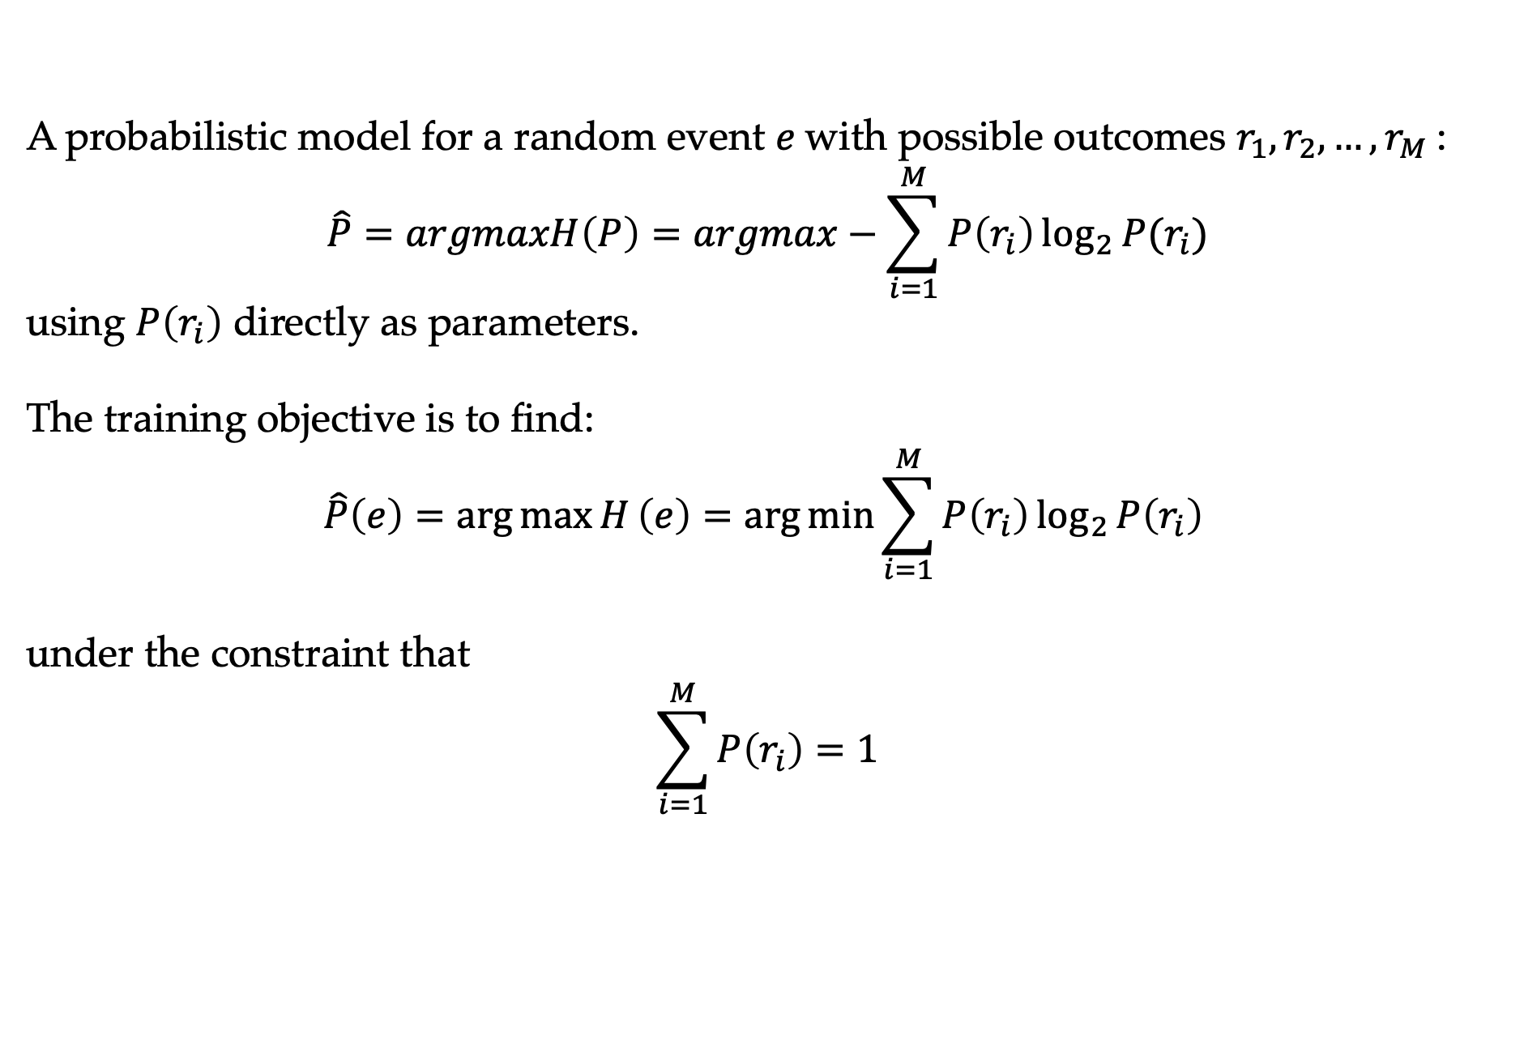
A Naïve Maximum Entropy Model
A probabilistic model for a random event $e$with possible outcomes $r_{1},r_{2},…,r_{M}$:
$$\hat{P}=argmaxH\left(P\right)=argmax−\sum_{i=1}^{M}{P\left(r_{i}\right)\log_{2}{P(r_{i})}}$$
using $P\left(r_{i}\right)$ directly as parameters.
The training objective is to find:
$$\hat{P}\left(e\right)=\arg{\max{H}}\left(e\right)=\arg{\min{\sum_{i=1}^{M}{P\left(r_{i}\right)\log_{2}{P\left(r_{i}\right)}}}}$$
under the constraint that
$$\sum_{i=1}^{M}{P\left(r_{i}\right)}=1$$

Slide 15
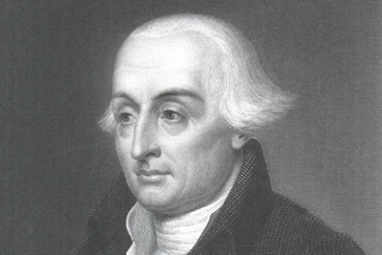
A Naïve Maximum Entropy Model
Taking each $P\left(r_{i}\right)$ as a separate variable, we use Lagrange multipliers to do the optimization.
In mathematic optimization, the method of Lagrange multipliers is a strategy for finding the local maxima and minima of a function subject to equality constraints.

Slide 16
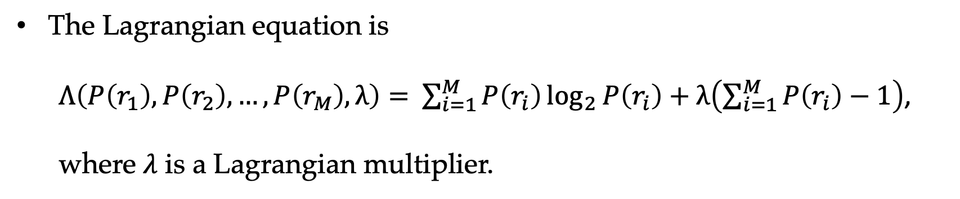
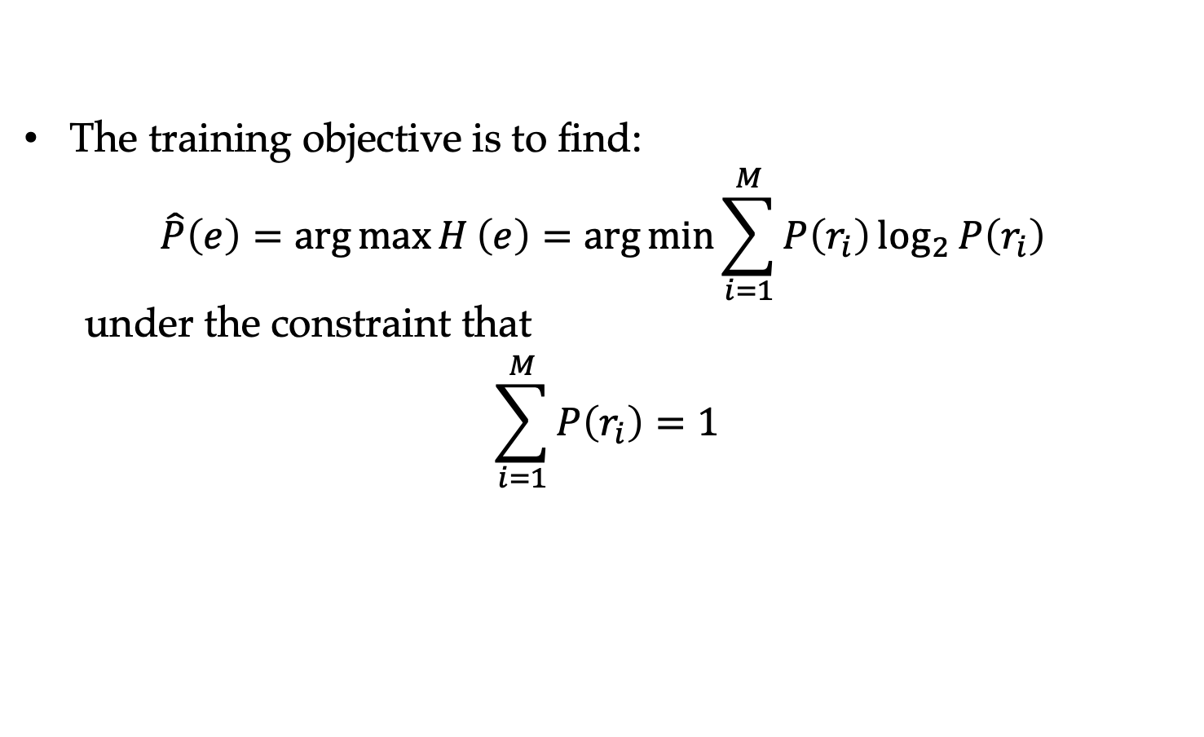
A Naïve Maximum Entropy Model
The training objective is to find:
$$\hat{P}\left(e\right)=\arg{\max{H}}\left(e\right)=\arg{\min{\sum_{i=1}^{M}{P\left(r_{i}\right)\log_{2}{P\left(r_{i}\right)}}}}$$
under the constraint that
$$\sum_{i=1}^{M}{P\left(r_{i}\right)}=1$$
The Lagrangian equation is
$Λ\left(P\left(r_{1}\right),P\left(r_{2}\right),…,P\left(r_{M}\right),λ\right)=$ $\sum_{i=1}^{M}{P\left(r_{i}\right)\log_{2}{P\left(r_{i}\right)}}+λ\left(\sum_{i=1}^{M}{P\left(r_{i}\right)}−1\right)$,
where $λ$ is a Lagrangian multiplier.

Slide 17
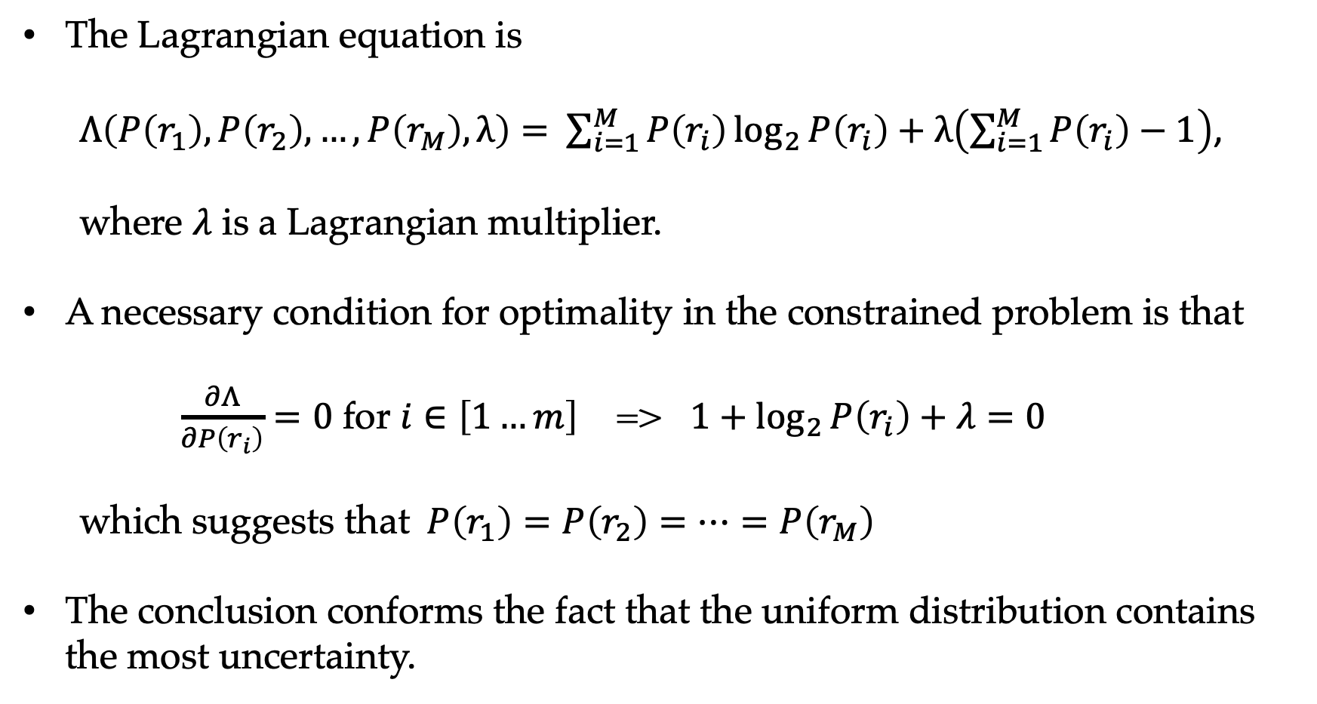
A Naïve Maximum Entropy Model
The Lagrangian equation is
$Λ\left(P\left(r_{1}\right),P\left(r_{2}\right),…,P\left(r_{M}\right),λ\right)=$ $\sum_{i=1}^{M}{P\left(r_{i}\right)\log_{2}{P\left(r_{i}\right)}}+λ\left(\sum_{i=1}^{M}{P\left(r_{i}\right)}−1\right)$,
where $λ$ is a Lagrangian multiplier.
A necessary condition for optimality in the constrained problem is that
$\frac{∂Λ}{∂P\left(r_{i}\right)}=0$ for $i∈\left[1…m\right]$ => $1+\log_{2}{P\left(r_{i}\right)}+λ=0$
which suggests that $P\left(r_{1}\right)=P\left(r_{2}\right)=⋯=P\left(r_{M}\right)$
The conclusion conforms the fact that the uniform distribution contains the most uncertainty.

Slide 18
Contents
6.1 The maximum entropy principle
6.1.1 Information and entropy
6.1.2 A naïve maximum entropy model
6.1.3 Maximum entropy model and training data
6.2 KL-Divergence, Cross-Entropy and Model Perplexity
6.2.1 KL-divergence
6.2.2 Cross entropy
6.2.3 Model Perplexity
6.3 Mutual information
6.3.1 Pointwise mutual information
6.3.2 Using PMI
6.4 Vector Representation of Words

Slide 19
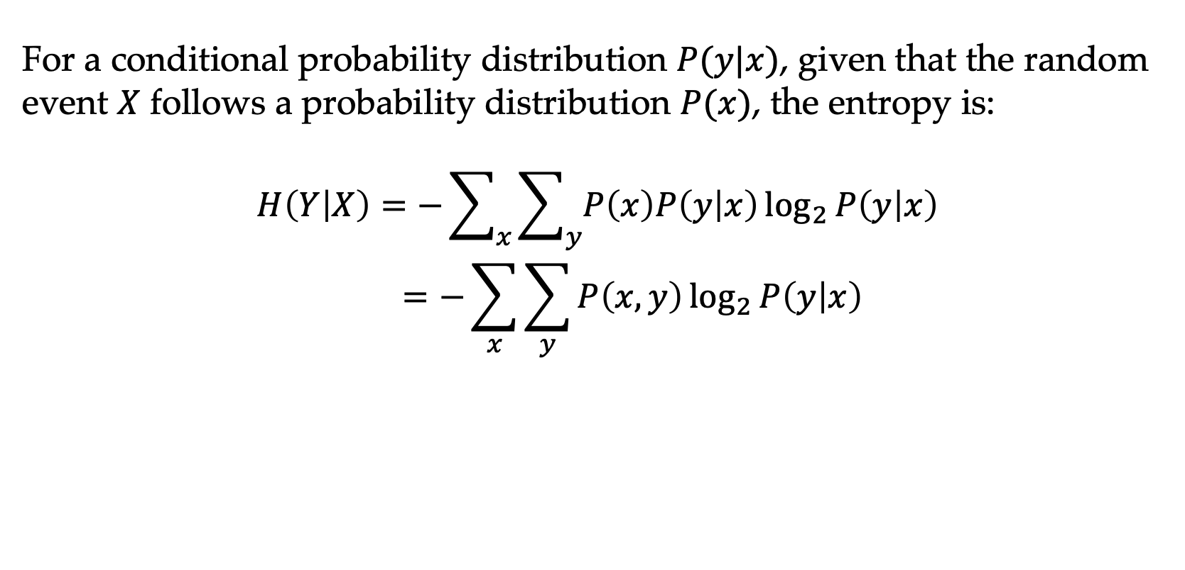
Conditional Entropy
For a conditional probability distribution $P(y|x)$, given that the random event $X$ follows a probability distribution $P(x)$, the entropy is:
$$H\left(Y | X\right)=−\sum_{x}{\sum_{y}{P\left(x\right)P\left(y | x\right)\log_{2}{P\left(y | x\right)}}}$$
$$=−\sum_{x}{\sum_{y}{P\left(x,y\right)\log_{2}{P\left(y | x\right)}}}$$

Slide 20
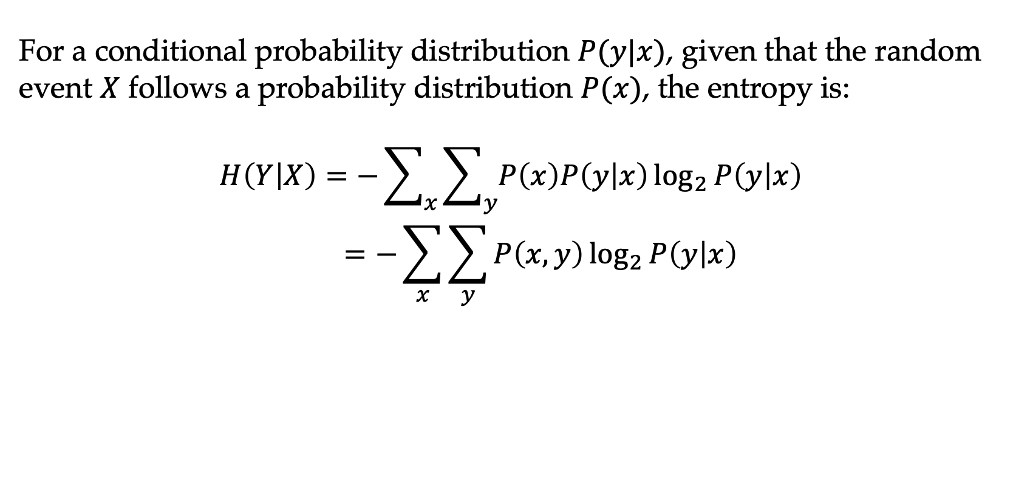
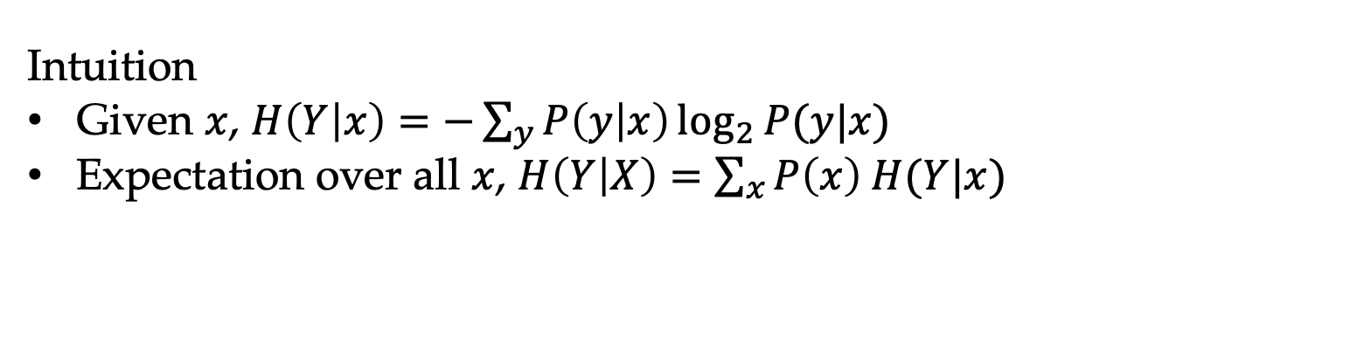
Conditional Entropy
For a conditional probability distribution $P(y|x)$, given that the random event $X$ follows a probability distribution $P(x)$, the entropy is:
$$H\left(Y | X\right)=−\sum_{x}{\sum_{y}{P\left(x\right)P\left(y | x\right)\log_{2}{P\left(y | x\right)}}}$$
$$=−\sum_{x}{\sum_{y}{P\left(x,y\right)\log_{2}{P\left(y | x\right)}}}$$
Intuition
Given $x$, $H\left(Y | x\right)=−\sum_{y}{P\left(y | x\right)\log_{2}{P(y|x)}}$
Expectation over all $x$, $H\left(Y | X\right)=\sum_{x}{P\left(x\right) H(Y|x)}$

Slide 21
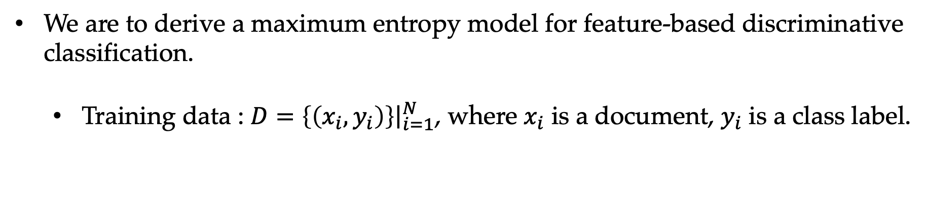
Maximum Entropy Model and Training Data
We are to derive a maximum entropy model for feature-based discriminative classification.
Training data : $D={\left.\left\{\left(x_{i},y_{i}\right)\right\}\right|}_{i=1}^{N}$, where $x_{i}$ is a document, $y_{i}$ is a class label.

Slide 22
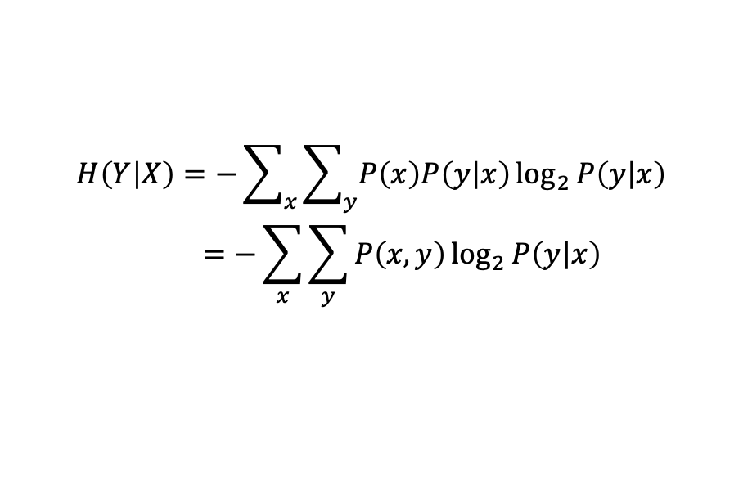
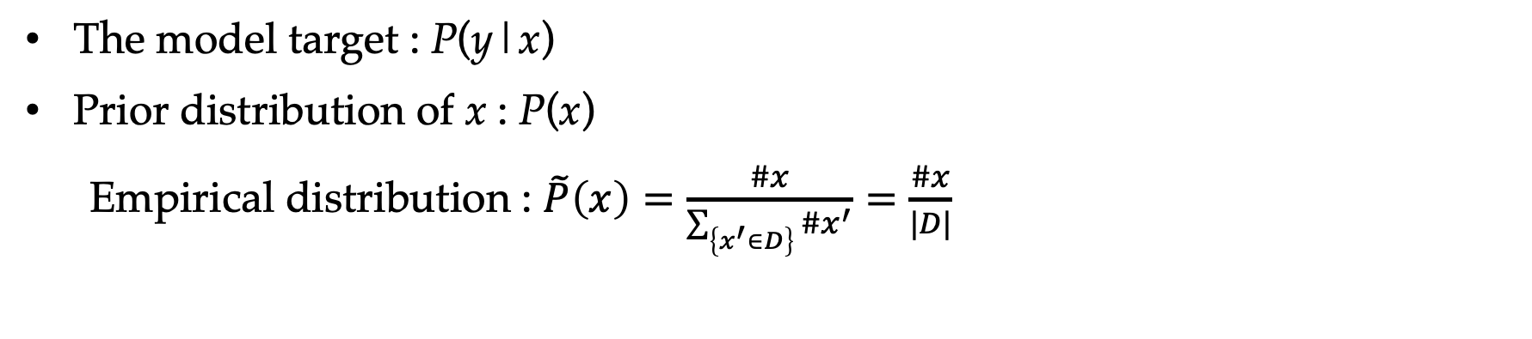
The Maximum Entropy Training Objective
The model target : P(y|x)
Prior distribution of x : P(x)
Empirical distribution : $\tilde{P}\left(x\right)=\frac{\#x}{\sum_{\left\{x^{′}∈D\right\}}{\#x^{′}}}=\frac{\#x}{|D|}$
$$H\left(Y | X\right)=−\sum_{x}{\sum_{y}{P\left(x\right)P\left(y | x\right)\log_{2}{P\left(y | x\right)}}}$$
$$=−\sum_{x}{\sum_{y}{P\left(x,y\right)\log_{2}{P\left(y | x\right)}}}$$

Slide 23
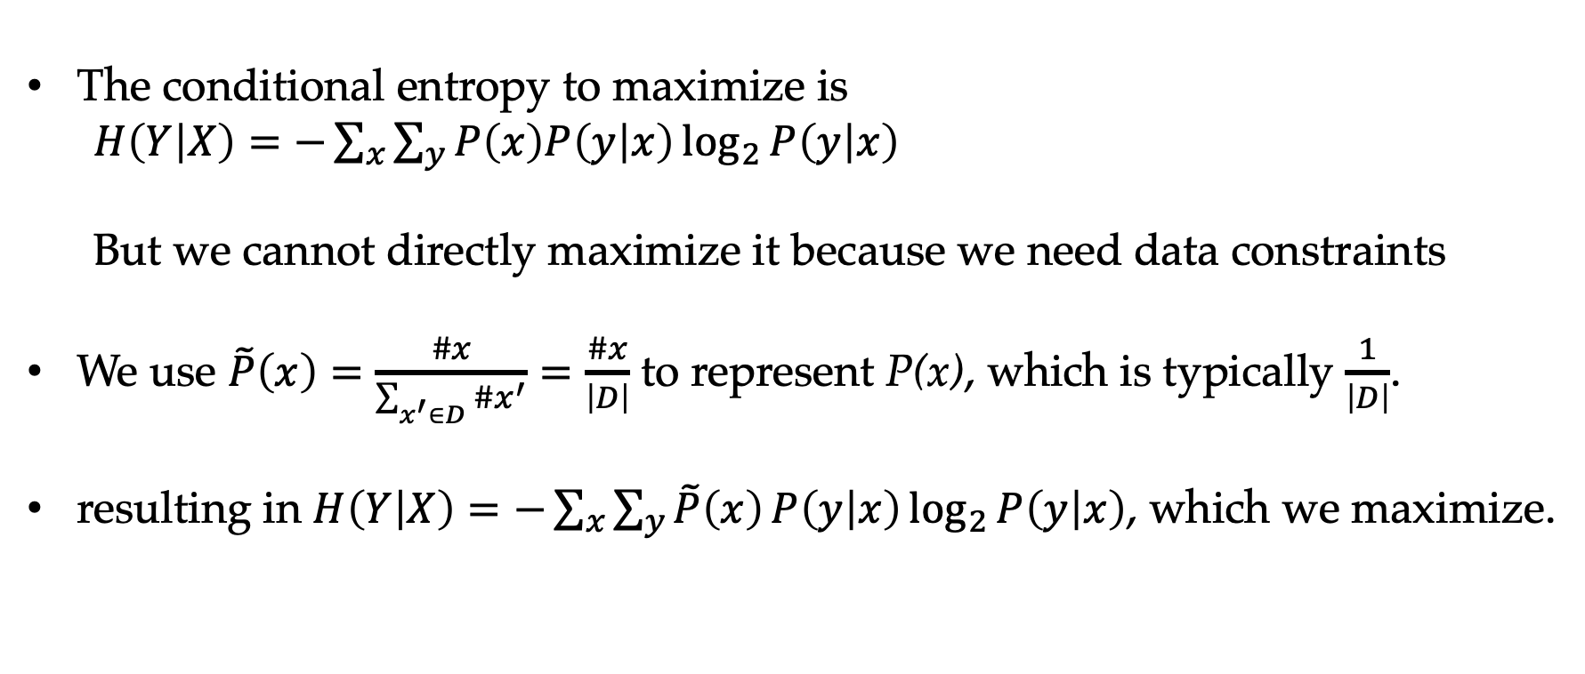
The Maximum Entropy Training Objective
The conditional entropy to maximize is
$H\left(Y | X\right)=−\sum_{x}{\sum_{y}{P\left(x\right)P\left(y | x\right)\log_{2}{P\left(y | x\right)}}}$
But we cannot directly maximize it because we need data constraints
We use $\tilde{P}\left(x\right)=\frac{\#x}{\sum_{x^{′}∈D}{\#x^{′}}}=\frac{\#x}{\left|D\right|}$ to represent P(x), which is typically $\frac{1}{\left|D\right|}$.
resulting in $H\left(Y | X\right)=−\sum_{x}{\sum_{y}{\tilde{P}\left(x\right)}P\left(y | x\right)\log_{2}{P\left(y | x\right)}}$, which we maximize.

Slide 24
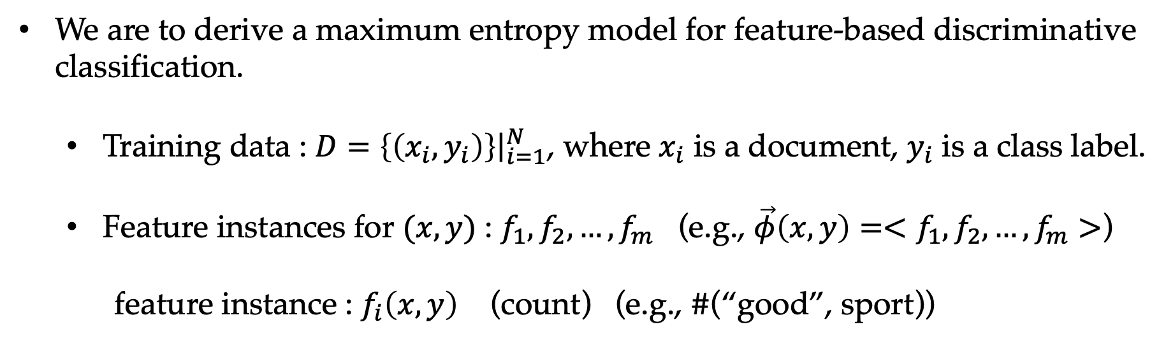
Maximum Entropy Model and Training Data
We are to derive a maximum entropy model for feature-based discriminative classification.
Training data : $D={\left.\left\{\left(x_{i},y_{i}\right)\right\}\right|}_{i=1}^{N}$, where $x_{i}$ is a document, $y_{i}$ is a class label.
Feature instances for $(x,y)$ : $f_{1},f_{2},…,f_{m}$ (e.g., $\vec{φ}\left(x,y\right)=<f_{1},f_{2},…,f_{m}>$)
feature instance : $f_{i}\left(x,y\right)$ (count) (e.g., $\#$(“good”, sport))

Slide 25
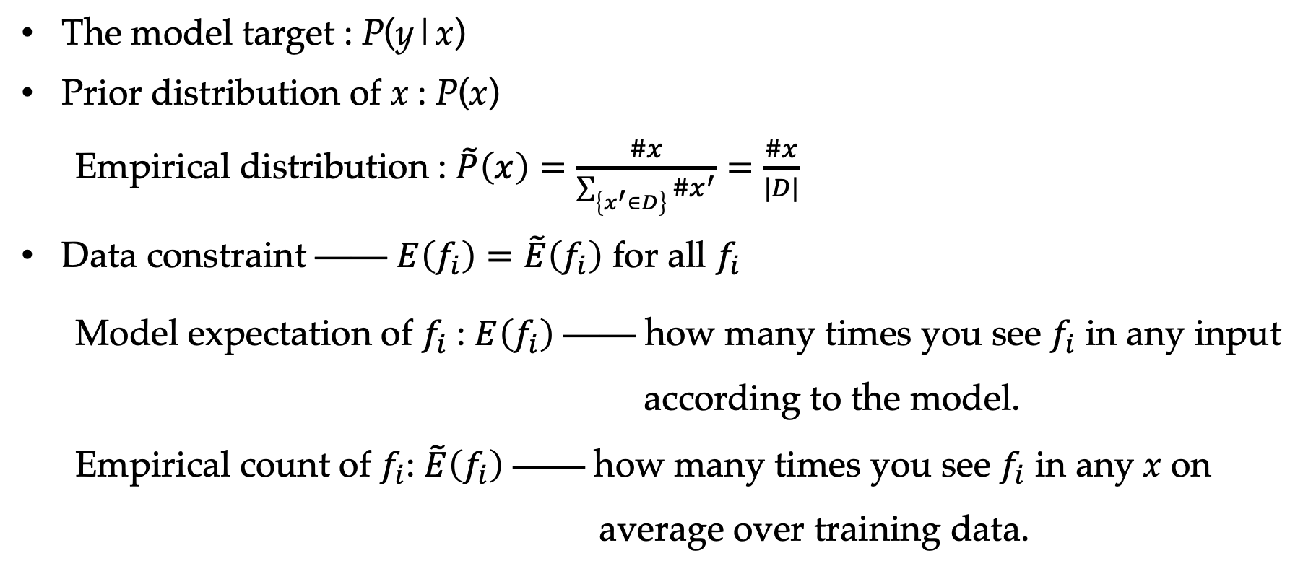
The Maximum Entropy Training Objective
The model target : P(y|x)
Prior distribution of x : P(x)
Empirical distribution : $\tilde{P}\left(x\right)=\frac{\#x}{\sum_{\left\{x^{′}∈D\right\}}{\#x^{′}}}=\frac{\#x}{|D|}$
Data constraint —— $E\left(f_{i}\right)=\tilde{E}\left(f_{i}\right)$ for all $f_{i}$
Model expectation of $f_{i}$ : $E\left(f_{i}\right)$ —— how many times you see $f_{i}$ in any input according to the model.
Empirical count of $f_{i}$: $\tilde{E}\left(f_{i}\right)$ —— how many times you see $f_{i}$ in any x on average over training data.
$$H\left(Y | X\right)=−\sum_{x}{\sum_{y}{P\left(x\right)P\left(y | x\right)\log_{2}{P\left(y | x\right)}}}$$
$$=−\sum_{x}{\sum_{y}{P\left(x,y\right)\log_{2}{P\left(y | x\right)}}}$$

Slide 26
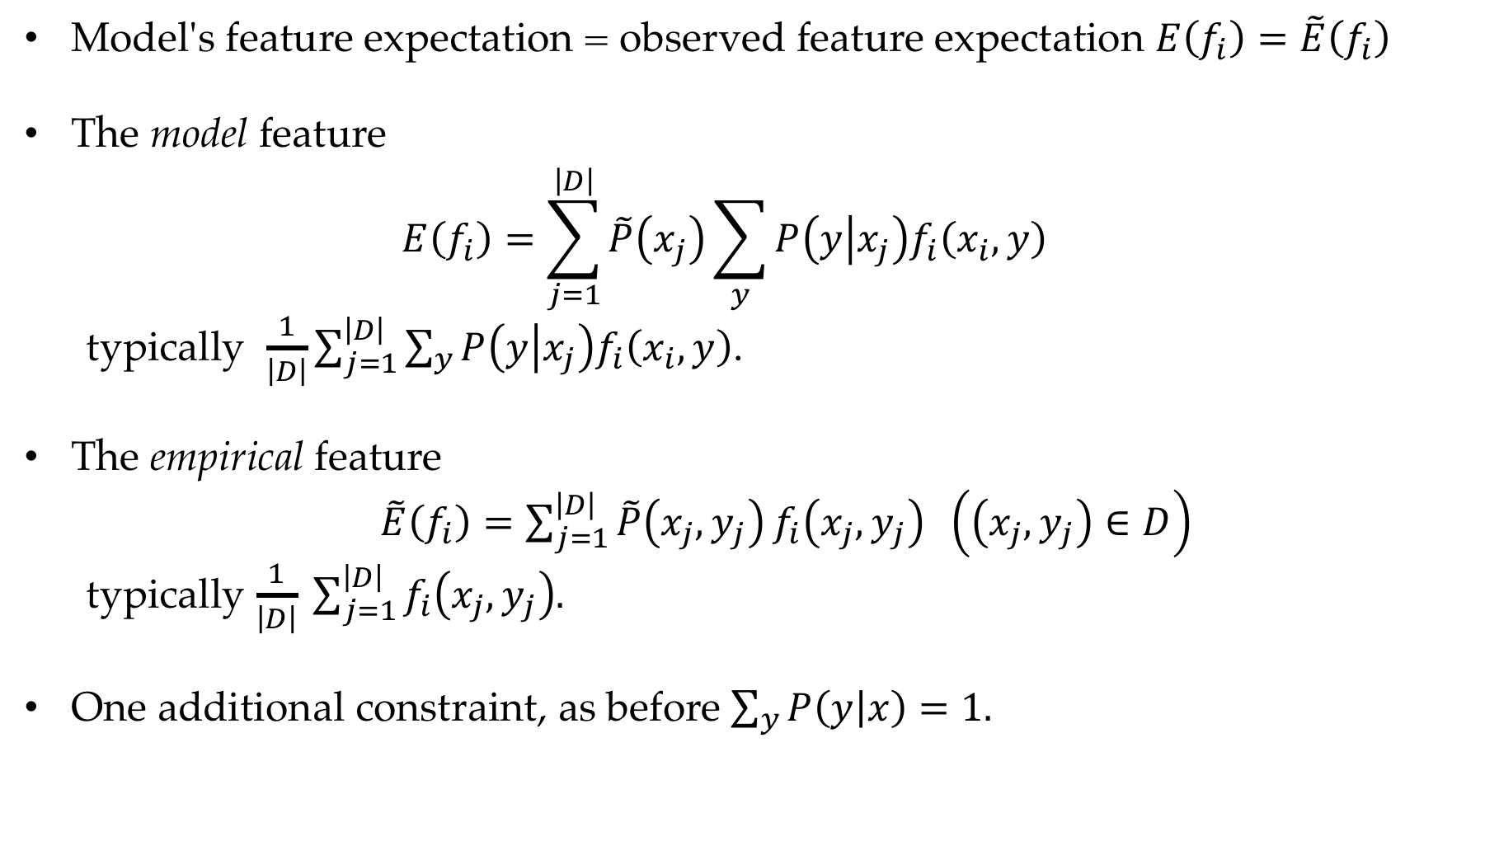
Constraints
Model's feature expectation = observed feature expectation $E\left(f_{i}\right)=\tilde{E}\left(f_{i}\right)$
The model feature
$$E\left(f_{i}\right)=\sum_{j=1}^{\left|D\right|}{\tilde{P}\left(x_{j}\right)\sum_{y}{P\left(y | x_{j}\right)f_{i}\left(x_{i},y\right)}}$$
typically $\frac{1}{\left|D\right|}\sum_{j=1}^{\left|D\right|}{\sum_{y}{P\left(y | x_{j}\right)f_{i}\left(x_{i},y\right)}}$.
The empirical feature
$\tilde{E}\left(f_{i}\right)=\sum_{j=1}^{\left|D\right|}{\tilde{P}\left(x_{j},y_{j}\right)}f_{i}\left(x_{j},y_{j}\right) \left(\left(x_{j},y_{j}\right)∈D\right)$
typically $\frac{1}{\left|D\right|} \sum_{j=1}^{\left|D\right|}{f_{i}\left(x_{j},y_{j}\right).}$
One additional constraint, as before $\sum_{y}{P\left(y | x\right)}=1.$

Slide 27
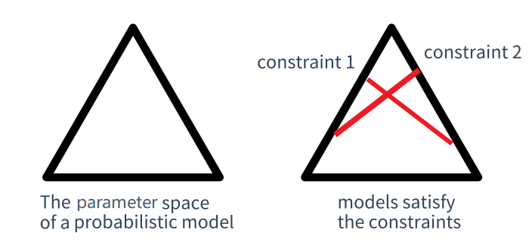
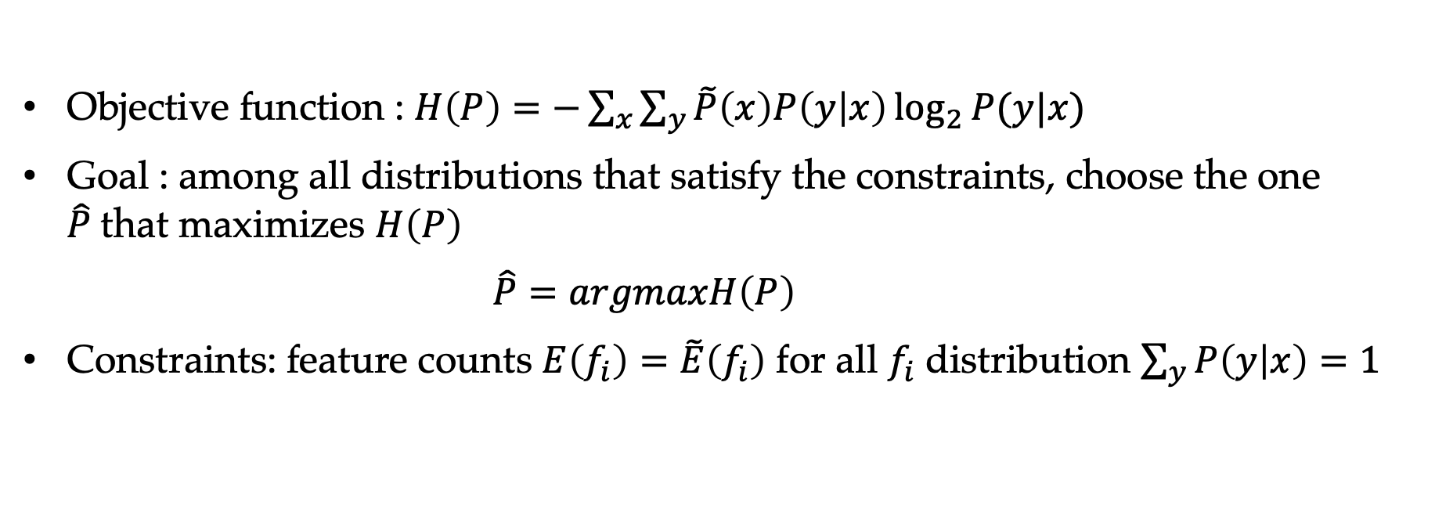
The Maximum Entropy Training Objective
Objective function : $H\left(P\right)=−\sum_{x}{\sum_{y}{\tilde{P}\left(x\right)P\left(y | x\right)\log_{2}{P(y|x)}}}$
Goal : among all distributions that satisfy the constraints, choose the one $\hat{P}$that maximizes $H\left(P\right)$
$\hat{P}=argmaxH\left(P\right)$
Constraints: feature counts $E\left(f_{i}\right)=\tilde{E}\left(f_{i}\right)$ for all $f_{i}$ distribution $\sum_{y}{P\left(y | x\right)}=1$

Slide 28
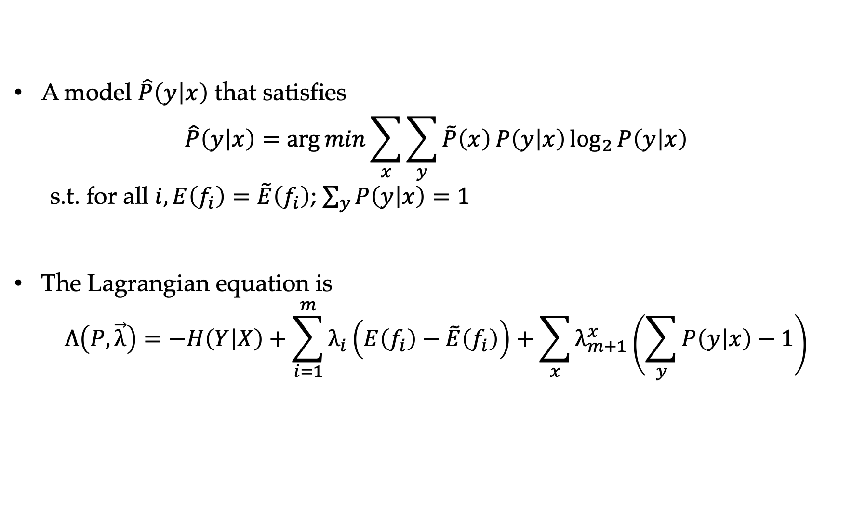
Using Lagrangian Multipliers
A model $\hat{P}\left(y | x\right)$ that satisfies
$$\hat{P}\left(y | x\right)=\arg{min}\sum_{x}{\sum_{y}{\tilde{P}\left(x\right)}P\left(y | x\right)\log_{2}{P\left(y | x\right)}}$$
s.t. for all $i,E\left(f_{i}\right)=\tilde{E}\left(f_{i}\right)$; $\sum_{y}{P\left(y | x\right)}=1$
The Lagrangian equation is
$$Λ\left(P,\vec{λ}\right)=−H\left(Y | X\right)+\sum_{i=1}^{m}{λ_{i}\left(E\left(f_{i}\right)−\tilde{E}\left(f_{i}\right)\right)}+\sum_{x}{λ_{m+1}^{x}\left(\sum_{y}{P\left(y | x\right)}−1\right)}$$

Slide 29
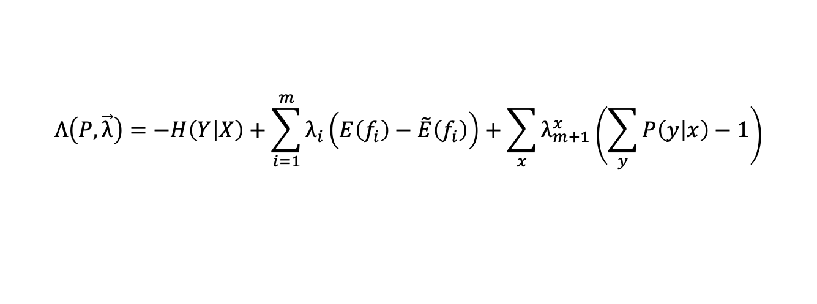
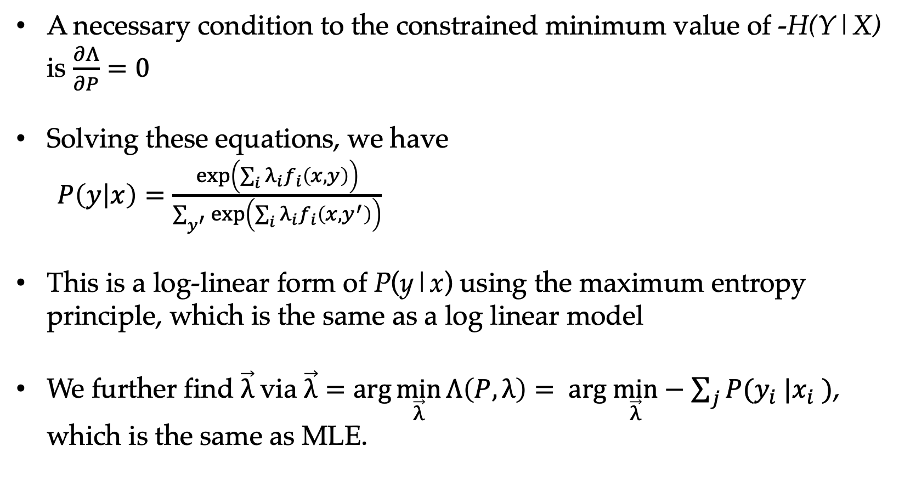
Maximum Entropy Leads to Log-linear Models
$$Λ\left(P,\vec{λ}\right)=−H\left(Y | X\right)+\sum_{i=1}^{m}{λ_{i}\left(E\left(f_{i}\right)−\tilde{E}\left(f_{i}\right)\right)}+\sum_{x}{λ_{m+1}^{x}\left(\sum_{y}{P\left(y | x\right)}−1\right)}$$
A necessary condition to the constrained minimum value of -H(Y|X) is $\frac{∂Λ}{∂P}=0$
Solving these equations, we have
$P\left(y | x\right)=\frac{\exp\left(\sum_{i}{λ_{i}}f_{i}\left(x,y\right)\right)}{\sum_{y^{′}}{\exp\left(\sum_{i}{λ_{i}}f_{i}\left(x,y^{′}\right)\right)}}$
This is a log-linear form of P(y|x) using the maximum entropy principle, which is the same as a log linear model
We further find $\vec{λ}$ via $\vec{λ}=\arg{\min_{\vec{λ}}{Λ\left(P,λ\right)}}= arg \min_{\vec{λ}}−\sum_{j}{P(y_{i} |x_{i} )}$, which is the same as MLE.

Slide 30
Contents
6.1 The maximum entropy principle
6.1.1 Information and entropy
6.1.2 A naïve maximum entropy model
6.1.3 Maximum entropy model and training data
6.2 KL-Divergence, Cross-Entropy and Model Perplexity
6.2.1 KL-divergence
6.2.2 Cross entropy
6.2.3 Model Perplexity
6.3 Mutual information
6.3.1 Pointwise mutual information
6.3.2 Using PMI
6.4 Vector Representation of Words

Slide 31
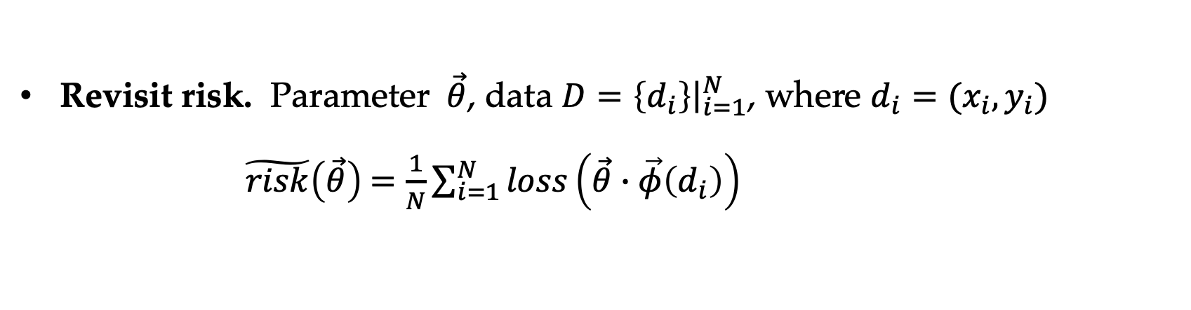
KL-Divergence
Revisit risk. Parameter $\vec{θ}$, data $D=\left\{d_{i}\right\}{\left.​\right|}_{i=1}^{N}$, where $d_{i}=(x_{i},y_{i})$
$\tilde{risk}\left(\vec{θ}\right)$ $=\frac{1}{N}\sum_{i=1}^{N}{loss\left(\vec{θ}∙\vec{φ}\left(d_{i}\right)\right)}$

Slide 32
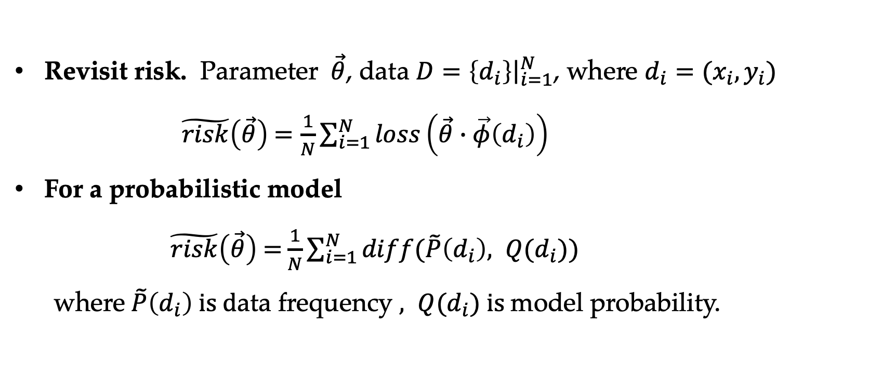
KL-Divergence
Revisit risk. Parameter $\vec{θ}$, data $D=\left\{d_{i}\right\}{\left.​\right|}_{i=1}^{N}$, where $d_{i}=(x_{i},y_{i})$
$\tilde{risk}\left(\vec{θ}\right)$ $=\frac{1}{N}\sum_{i=1}^{N}{loss\left(\vec{θ}∙\vec{φ}\left(d_{i}\right)\right)}$
For a probabilistic model
$\tilde{risk}\left(\vec{θ}\right)$ $=$ $\frac{1}{N}\sum_{i=1}^{N}{diff(\tilde{P}\left(d_{i}\right), Q(d_{i}))}$ where $\tilde{P}\left(d_{i}\right) is d$ata frequency $, Q(d_{i}) is$model probability.

Slide 33
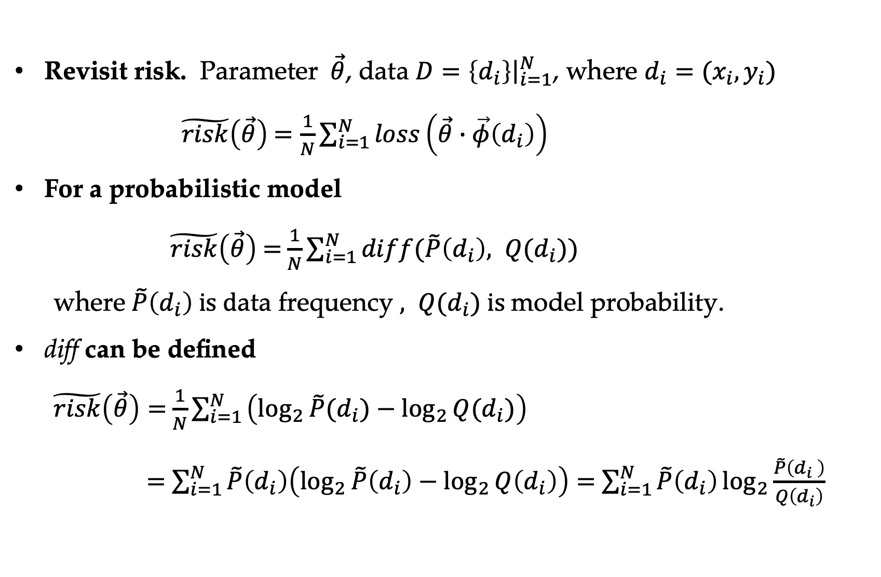
KL-Divergence
Revisit risk. Parameter $\vec{θ}$, data $D=\left\{d_{i}\right\}{\left.​\right|}_{i=1}^{N}$, where $d_{i}=(x_{i},y_{i})$
$\tilde{risk}\left(\vec{θ}\right)$ $=\frac{1}{N}\sum_{i=1}^{N}{loss\left(\vec{θ}∙\vec{φ}\left(d_{i}\right)\right)}$
For a probabilistic model
$\tilde{risk}\left(\vec{θ}\right)$ $=$ $\frac{1}{N}\sum_{i=1}^{N}{diff(\tilde{P}\left(d_{i}\right), Q(d_{i}))}$ where $\tilde{P}\left(d_{i}\right) is d$ata frequency $, Q(d_{i}) is$model probability.
diff can be defined
$\tilde{risk}\left(\vec{θ}\right)=$ $\frac{1}{N}\sum_{i=1 }^{N}{\left(\log_{2}{\tilde{P}(d_{i})}−\log_{2}{Q(d_{i})}\right)}$
$=$ $\sum_{i=1}^{N}{\tilde{P}\left(d_{i}\right)\left(\log_{2}{\tilde{P}\left(d_{i}\right)}−\log_{2}{Q\left(d_{i}\right)}\right)}=$ $\sum_{i=1}^{N}{\tilde{P}\left(d_{i}\right)}\log_{2}{\frac{\tilde{P}\left(d_{i} \right)}{Q\left(d_{i}\right)}}$

Slide 34
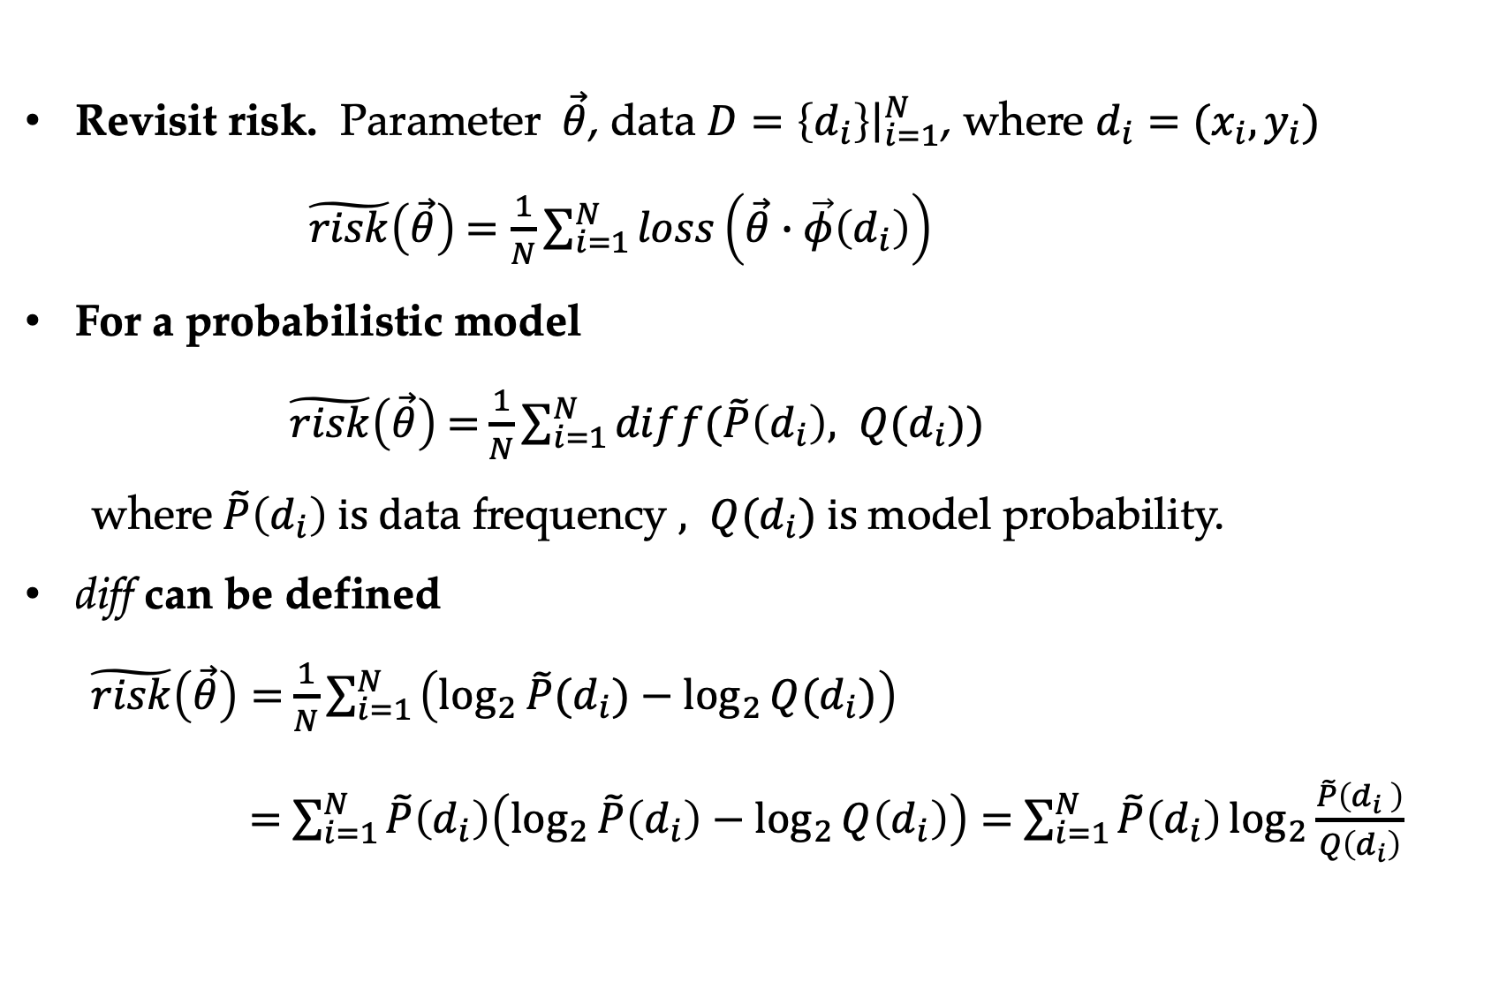
KL-Divergence
Revisit risk. Parameter $\vec{θ}$, data $D=\left\{d_{i}\right\}{\left.​\right|}_{i=1}^{N}$, where $d_{i}=(x_{i},y_{i})$
$\tilde{risk}\left(\vec{θ}\right)$ $=\frac{1}{N}\sum_{i=1}^{N}{loss\left(\vec{θ}∙\vec{φ}\left(d_{i}\right)\right)}$
For a probabilistic model
$\tilde{risk}\left(\vec{θ}\right)$ $=$ $\frac{1}{N}\sum_{i=1}^{N}{diff(\tilde{P}\left(d_{i}\right), Q(d_{i}))}$ where $\tilde{P}\left(d_{i}\right) is d$ata frequency $, Q(d_{i}) is$model probability.
diff can be defined
$\tilde{risk}\left(\vec{θ}\right)=$ $\frac{1}{N}\sum_{i=1 }^{N}{\left(\log_{2}{\tilde{P}(d_{i})}−\log_{2}{Q(d_{i})}\right)}$
$=$ $\sum_{i=1}^{N}{\tilde{P}\left(d_{i}\right)\left(\log_{2}{\tilde{P}\left(d_{i}\right)}−\log_{2}{Q\left(d_{i}\right)}\right)}=$ $\sum_{i=1}^{N}{\tilde{P}\left(d_{i}\right)}\log_{2}{\frac{\tilde{P}\left(d_{i} \right)}{Q\left(d_{i}\right)}}$

Slide 35
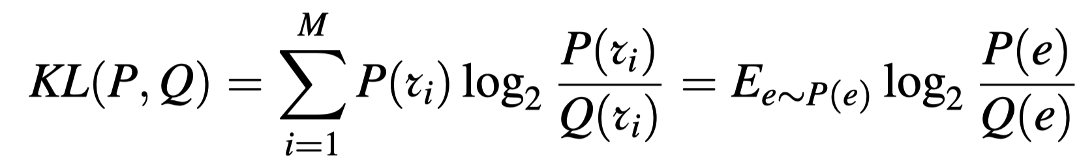
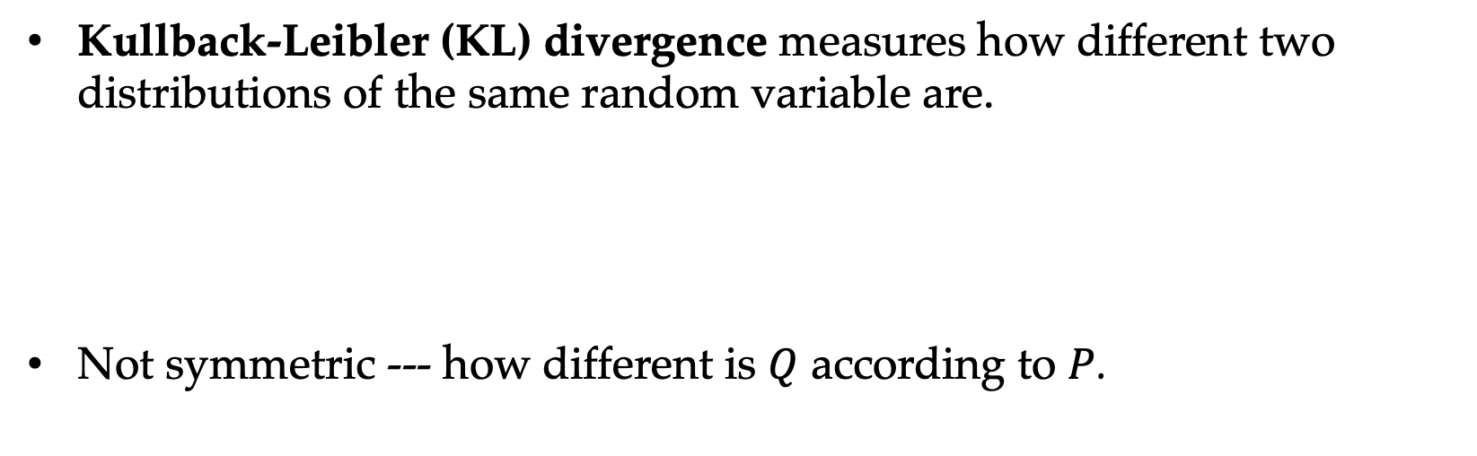
KL-Divergence
Kullback-Leibler (KL) divergence measures how different two distributions of the same random variable are.
Not symmetric --- how different is $Q$ according to $P$.

Slide 36
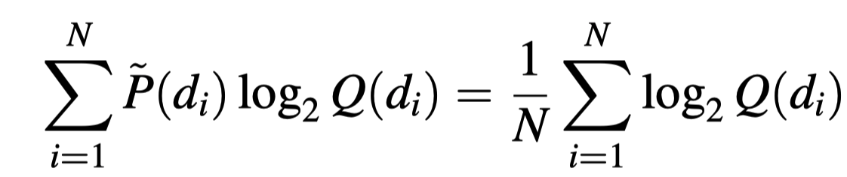
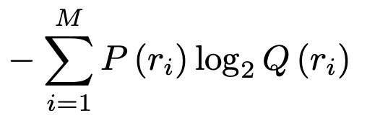
KL-Divergence
Loss function:
As the first term is constant, the loss effectively maximizes
which is the exactly log-likelihood of the dataset D, namely MLE.
What is this second term?

Slide 37
Contents
6.1 The maximum entropy principle
6.1.1 Information and entropy
6.1.2 A naïve maximum entropy model
6.1.3 Maximum entropy model and training data
6.2 KL-Divergence, Cross-Entropy and Model Perplexity
6.2.1 KL-divergence
6.2.2 Cross entropy
6.2.3 Model Perplexity
6.3 Mutual information
6.3.1 Pointwise mutual information
6.3.2 Using PMI
6.4 Vector Representation of Words

Slide 38
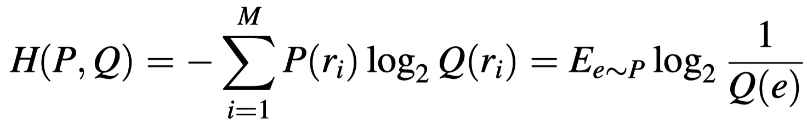
Cross Entropy
The second term of KL-divergence is referred to cross-entropy:
It also measures the similarity between two distributions of the same random variable.

Slide 39
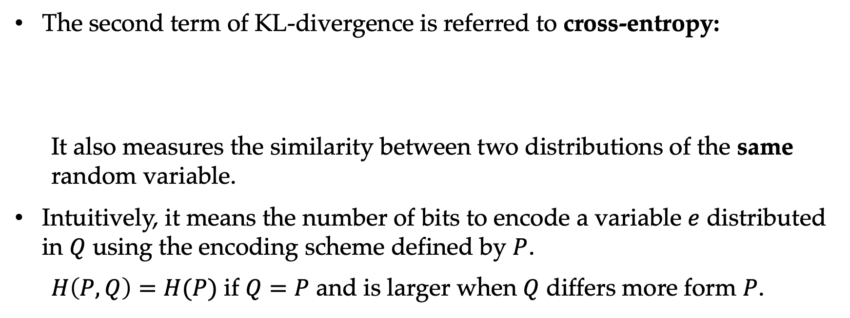
Cross Entropy
The second term of KL-divergence is referred to cross-entropy:
It also measures the similarity between two distributions of the same random variable.
Intuitively, it means the number of bits to encode a variable $e$ distributed in $Q$ using the encoding scheme defined by $P$.
$H\left(P, Q\right)=H(P)$ if $Q=P$ and is larger when $Q$ differs more form $P$.

Slide 40
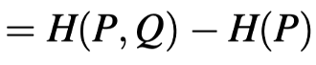
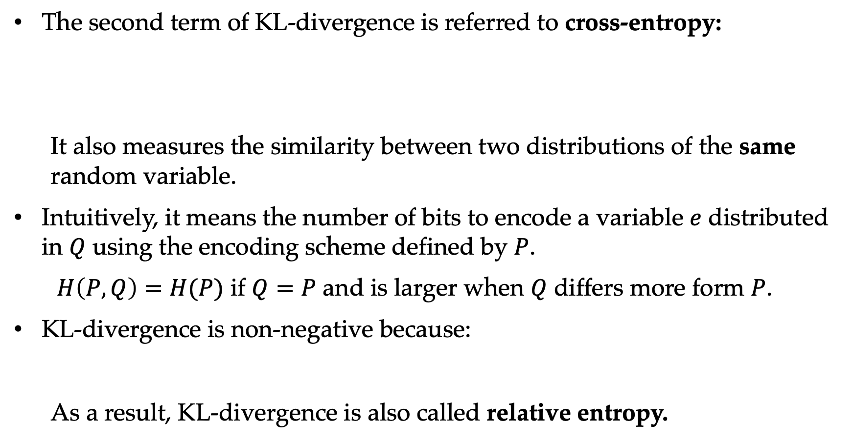
Cross Entropy
The second term of KL-divergence is referred to cross-entropy:
It also measures the similarity between two distributions of the same random variable.
Intuitively, it means the number of bits to encode a variable $e$ distributed in $Q$ using the encoding scheme defined by $P$.
$H\left(P, Q\right)=H(P)$ if $Q=P$ and is larger when $Q$ differs more form $P$.
KL-divergence is non-negative because:
As a result, KL-divergence is also called relative entropy.

Slide 41
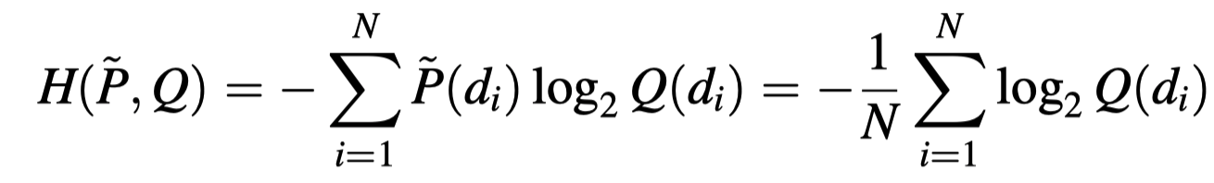
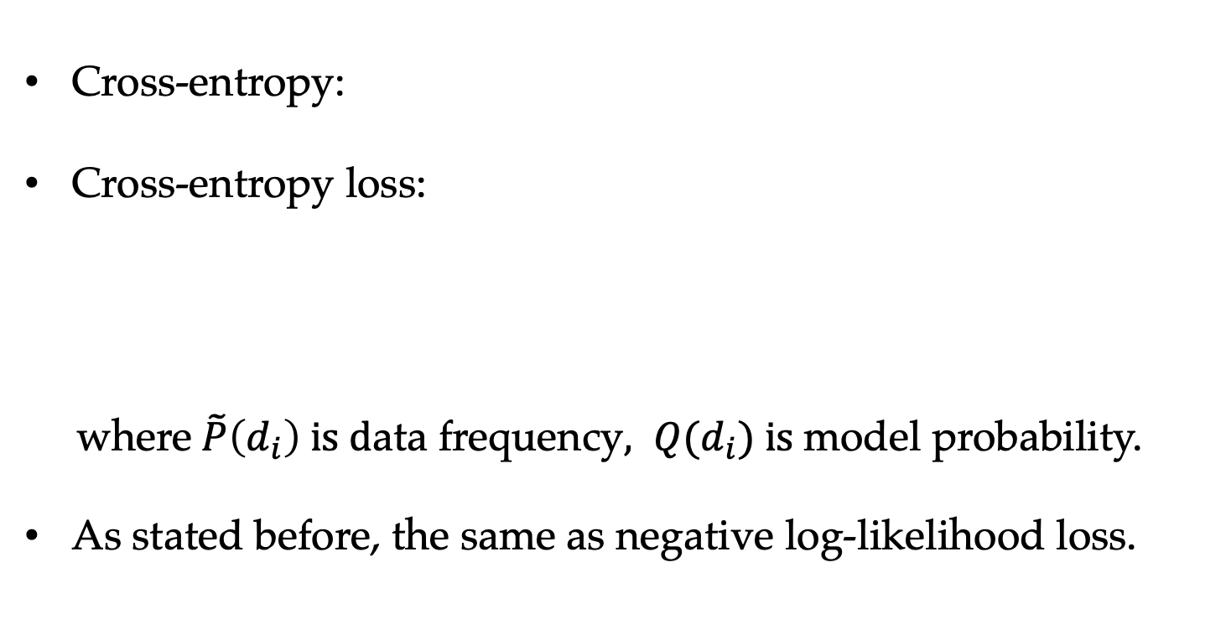
Cross Entropy Loss
Cross-entropy:
Cross-entropy loss:
where $\tilde{P}\left(d_{i}\right) is d$ata frequency$, Q(d_{i}) is$model probability.
As stated before, the same as negative log-likelihood loss.

Slide 42
Contents
6.1 The maximum entropy principle
6.1.1 Information and entropy
6.1.2 A naïve maximum entropy model
6.1.3 Maximum entropy model and training data
6.2 KL-Divergence, Cross-Entropy and Model Perplexity
6.2.1 KL-divergence
6.2.2 Cross entropy
6.2.3 Model Perplexity
6.3 Mutual information
6.3.1 Pointwise mutual information
6.3.2 Using PMI
6.4 Vector Representation of Words

Slide 43
Perplexity
Formally,
Intuitively, perplexity represents the expected number of choices you have with equal probability.
entropy = 0
perplexity = 1
entropy = 1
perplexity = 2
0 < entropy < 1
1 < perplexity < 2

Slide 44
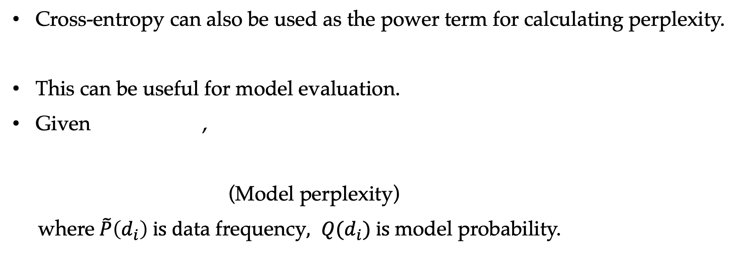
Model Perplexity
Cross-entropy can also be used as the power term for calculating perplexity.
This can be useful for model evaluation.
Given ,
(Model perplexity)
where $\tilde{P}\left(d_{i}\right) is d$ata frequency$, Q(d_{i}) is$model probability.

Slide 45
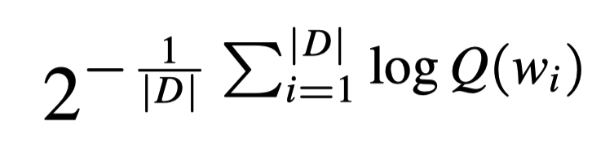
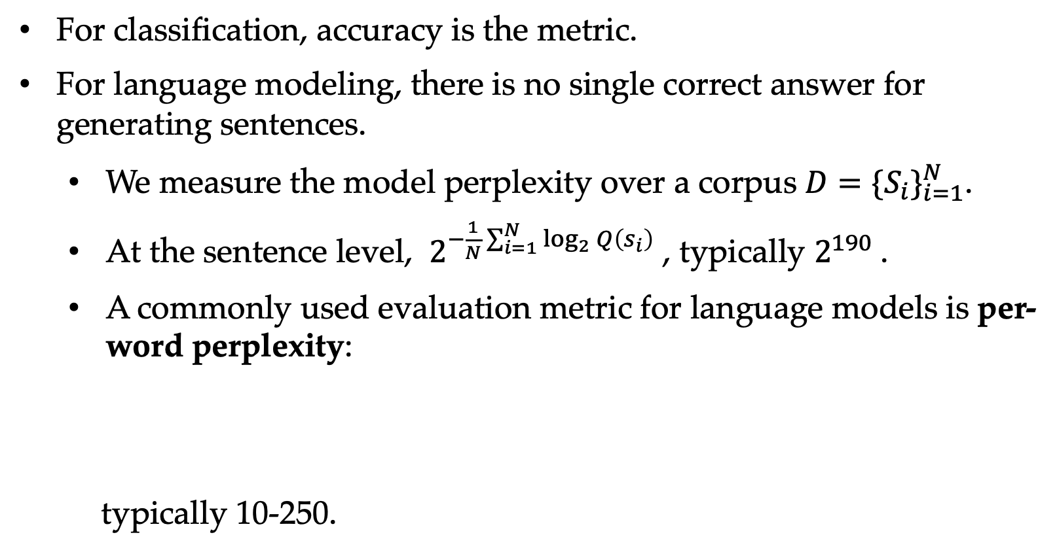
Evaluating Language Models
For classification, accuracy is the metric.
For language modeling, there is no single correct answer for generating sentences.
We measure the model perplexity over a corpus $D={\{S_{i}\}}_{i=1}^{N}$.
At the sentence level, $2^{−\frac{1}{N}\sum_{i=1}^{N}{\log_{2}{Q\left(s_{i}\right)}}}$ , typically $2^{190}$.
A commonly used evaluation metric for language models is per-word perplexity:
typically 10-250.

Slide 46
Contents
6.1 The maximum entropy principle
6.1.1 Information and entropy
6.1.2 A naïve maximum entropy model
6.1.3 Maximum entropy model and training data
6.2 KL-Divergence, Cross-Entropy and Model Perplexity
6.2.1 KL-divergence
6.2.2 Cross entropy
6.2.3 Model Perplexity
6.3 Mutual information
6.3.1 Pointwise mutual information
6.3.2 Using PMI
6.4 Vector Representation of Words

Slide 47
Entropy, Cross-Entropy, Mutual Information
Entropy – the expected number of bits to encode a random variable.
The number of bits in average when encoding many outcome values. Optimal encoding scheme.
Cross-Entropy – the expected number of bits to encode a random variable using a different encoding scheme. Two distributions concerning the same random variable.
Evaluate model distribution against data distribution
Calibrate model distribution against data.
Mutual Information – the expected number of bits you can save for encoding a random variable if a second random variable is known.
About two random variables.

Slide 48
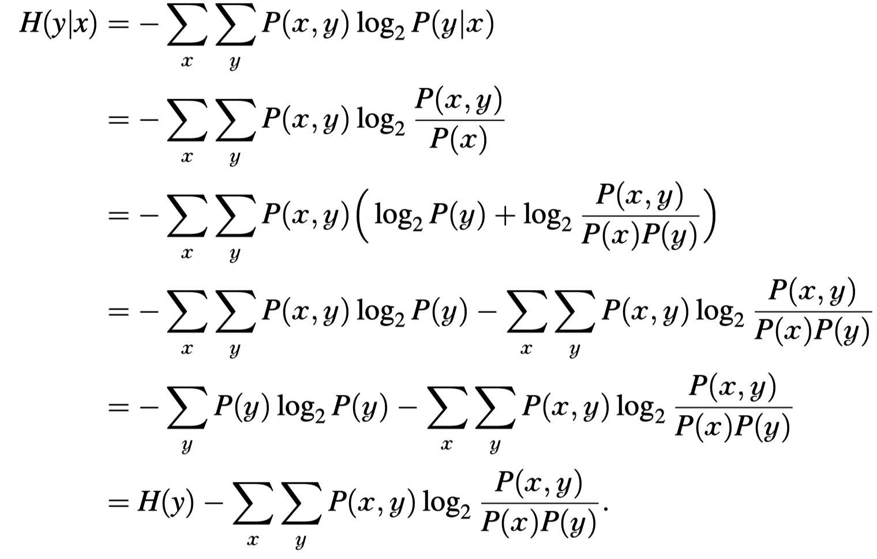
Mutual information

Slide 49
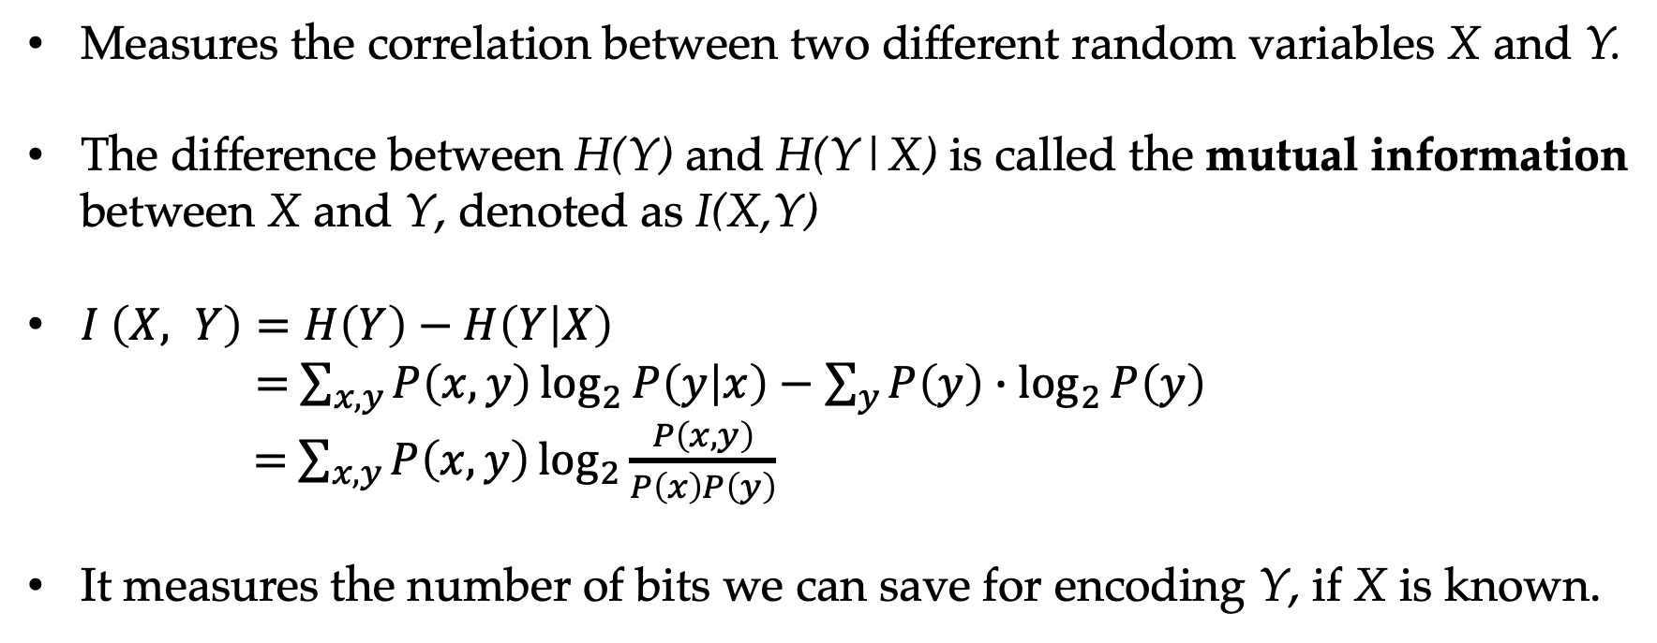
Mutual Information
Measures the correlation between two different random variables X and Y.
The difference between H(Y) and H(Y|X) is called the mutual information between X and Y, denoted as I(X,Y)
$I \left(X, Y\right)=H\left(Y\right)−H\left(Y | X\right)$
$=$ $\sum_{x,y}{P\left(x, y\right)\log_{2}{P\left(y | x\right)−\sum_{y}{P\left(y\right)∙\log_{2}{P\left(y\right)}}}}$
$=$ $\sum_{x,y}{P\left(x,y\right)\log_{2}{\frac{P\left(x, y\right)}{P\left(x\right)P\left(y\right)}}}$
It measures the number of bits we can save for encoding Y, if X is known.

Slide 50
Mutual Information
Measures the correlation between two different random variables X and Y.
The difference between H(Y) and H(Y|X) is called the mutual information between X and Y, denoted as I(X,Y)
$I \left(X, Y\right)=H\left(Y\right)−H\left(Y | X\right)$
$=$ $\sum_{x,y}{P\left(x, y\right)\log_{2}{P\left(y | x\right)−\sum_{y}{P\left(y\right)∙\log_{2}{P\left(y\right)}}}}$
$=$ $\sum_{x,y}{P\left(x,y\right)\log_{2}{\frac{P\left(x, y\right)}{P\left(x\right)P\left(y\right)}}}$
It measures the number of bits we can save for encoding Y, if X is known.

Slide 51
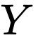
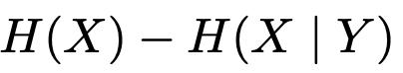


Mutual Information
Mutual information is symmetric between X and , is equal to

Slide 52
Mutual Information
Mutual information is symmetric between X and , is equal to

Slide 53

Conditional Entropy

Slide 54
Contents
6.1 The maximum entropy principle
6.1.1 Information and entropy
6.1.2 A naïve maximum entropy model
6.1.3 Maximum entropy model and training data
6.2 KL-Divergence, Cross-Entropy and Model Perplexity
6.2.1 KL-divergence
6.2.2 Cross entropy
6.2.3 Model Perplexity
6.3 Mutual information
6.3.1 Pointwise mutual information
6.3.2 Using PMI
6.4 Vector Representation of Words

Slide 55

Pointwise Mutual Information
Given two random events X and Y, their mutual information can be viewed as the expectation of $\log_{2}{\frac{P\left(x,y\right)}{P\left(x\right)P\left(y\right)}}$ over all x, y:
$$I\left(x,y\right)=\sum_{x,y}{P\left(x,y\right)\log_{2}{\frac{P\left(x,y\right)}{P\left(x\right)P\left(y\right)}}}=E_{x,y}\left(\log_{2}{\frac{P\left(x,y\right)}{P\left(x\right)P\left(y\right)}}\right)$$
For each outcome pair (x, y), $\log_{2}{\frac{P\left(x,y\right)}{P\left(x\right)P\left(y\right)}}$ is called Pointwise Mutual information (PMI) between x and y.

Slide 56

Pointwise Mutual Information
$$\log_{2}{\frac{P\left(x,y\right)}{P\left(x\right)P\left(y\right)}}$$
PMI represents the statistical correlation between two values of a random variable, or two outcomes of a random event.
How frequently they occur together vs individually.
PMI --- Mutual information information --- entropy
PMI can be negative!

Slide 57
Contents
6.1 The maximum entropy principle
6.1.1 Information and entropy
6.1.2 A naïve maximum entropy model
6.1.3 Maximum entropy model and training data
6.2 KL-Divergence, Cross-Entropy and Model Perplexity
6.2.1 KL-divergence
6.2.2 Cross entropy
6.2.3 Model Perplexity
6.3 Mutual information
6.3.1 Pointwise mutual information
6.3.2 Using PMI
6.4 Vector Representation of Words

Slide 58
Using PMI to Mine Knowledge from Texts
The correlation between random variable values.
Words and sentiment signals.
Neighboring words.
Features and class labels.

Slide 59

Learning Sentiment Lexicons
Sentiment lexicon contains information about the polarity and strength of sentiment words.
LEX(w) represents the sentiment polarity, and the absolute value represents the strength.
$$SENTI\left(d\right)=\frac{\sum_{i}{Lex\left(w_{i}\right)}}{\left|\left\{w_{i} | Lex\left(w_{i}\right)≠0\right\}\right|}$$

Slide 60


Learning Sentiment Lexicons
The PMI between a word w and a seed word
$PMI\left(w,seed\right)=log_{2}\frac{P\left(w,seed\right)}{P\left(w\right)p\left(seed\right)}$
$LEX\left(w\right)=PMI\left(w,\text{good}\right)−PMI\left(w,\text{bad}\right)$
Emoticons in social media

Slide 61


Collocation Extraction
Collocation refers to words that are conventionally used together for certain meaning.
Given two words $w_{1}$ and $w_{2}$ and a corpus D, there association can be calculated using
$$PMI\left(w_{1},w_{2}\right)=\log_{2}{\frac{P\left(w_{1}w_{2}\right)}{P\left(w_{1}\right)P\left(w_{2}\right)}}$$

Slide 62

Using PMI to Select Features
Feature selection: reduce the size of the feature vector
important features
PMI between feature and class is a commonly used metric for feature selection, the higher PMI value, the more likely w is a strong indicator of c.
unimportant features
(can be spurious patterns)

Slide 63
Contents
6.1 The maximum entropy principle
6.1.1 Information and entropy
6.1.2 A naïve maximum entropy model
6.1.3 Maximum entropy model and training data
6.2 KL-Divergence, Cross-Entropy and Model Perplexity
6.2.1 KL-divergence
6.2.2 Cross entropy
6.2.3 Model Perplexity
6.3 Mutual information
6.3.1 Pointwise mutual information
6.3.2 Using PMI
6.4 Vector Representation of Words

Slide 64


Vector Representations of Words
Representing a word in vector space
a ``one-hot’’ representation
$$<w_{1},w_{2}, ⋯⋯,w_{i}, ⋯⋯,w_{\left|V\right|}>$$
for the ith word in the vocabulary
$$<0, 0, ⋯⋯,1, ⋯⋯, 0>$$
It does not give semantic correlations.

Slide 65
Vector Representations of Words
You know the meaning of words by the neighbors.
Distributional semantics : the company of a word (k-word windows) tells us much information about its attributes.
”dogs” and “cats” both have “fur” ”tail” “legs” and “run” “jump”

Slide 66

Vector Representations of Words
k-word windows for the word "bank” in s1 --- There happened to be a rock sticking out of the water halfway between the bank and the island s2 --- The checks that have been written but are not included with the bank statement are called outstanding checks

Slide 67

Word Representation
cat --- 121, dog --- 500, considering vector dot product.

Slide 68

Word Representation
cat --- 121, dog --- 500, considering vector dot product.
more useful than one-hot
But $w_{1}=“a”$ (stop words) co-occur in both contexts.

Slide 69


PMI and Vector Representations of Words
The vector representation of a word $w_{i}$ is :
$$\overline{Vec\left(w_{i}\right)}=\left\langle PMI\left(w,w_{1}\right),PMI\left(w,w_{2}\right),…,PMI\left(w,w_{\left|V\right|}\right)\right\rangle$$

Slide 70
Word Representation
PMI plays a similar role to TF-IDF.

Slide 71

PMI and Vector Representations of Words
$PPMI\left(u,v\right)=max⁡(PMI\left(u,v \right),0)$
We use positive PMI (PPMI) to reduce noise and the non-informative.
Using PPMI, non differentiating words will have a small contribution to the distributional word representation.

Slide 72
Summary
Entropy and information.
The maximum entropy principle deriving log-linear model using maximum entropy.
Model perplexity, cross-entropy and KL-divergence.
Mutual information and pointwise mutual information (PMI).
Word representations and pointwise mutual information.

